Slide 1

uNit 8 – Wireless systems
Computing Systems

Slide 2
Index
Wireless systems
2G
GSM
GPRS/HSCSD
EDGE
3G UMTS
WCDMA
4G LTE
5G
Wimax
Wi-Fi
WEP
WPA
WPA2
Zigbee
Bluetooth

Slide 3
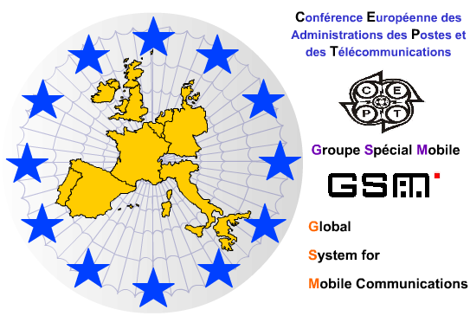
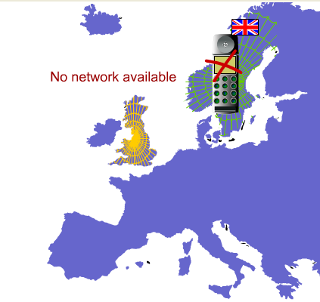
GSM
Global System for Mobile Communications
1979 several radio network exists.
CEPT created a Work Group (Group Special Mobile GSM).

Slide 4
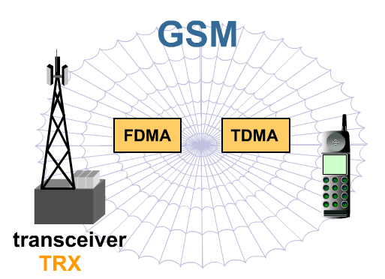
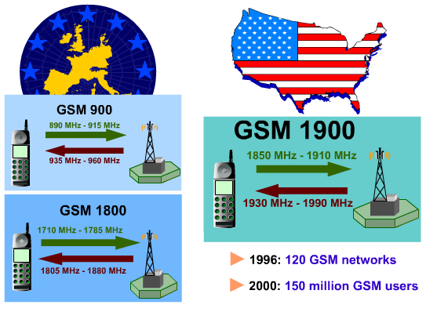
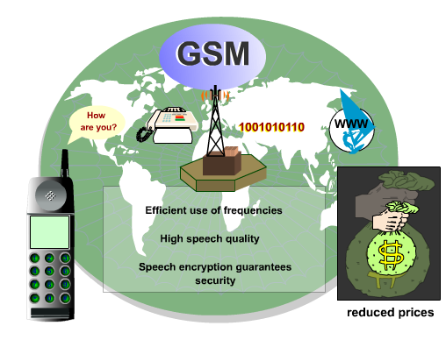
GSM bands
FDMA and TDMA

Slide 5
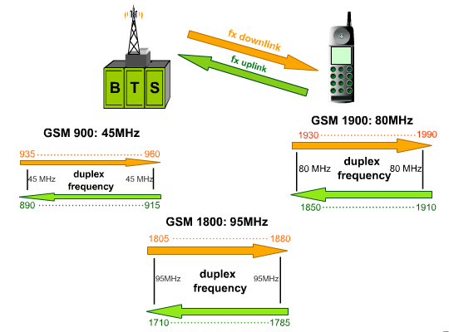
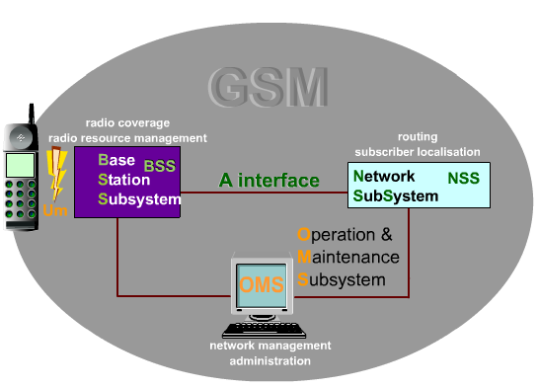
Duplex
GSM
Base Station Subsystem
Operation & Maintenance Subsystem
Network Subsystem

Slide 6
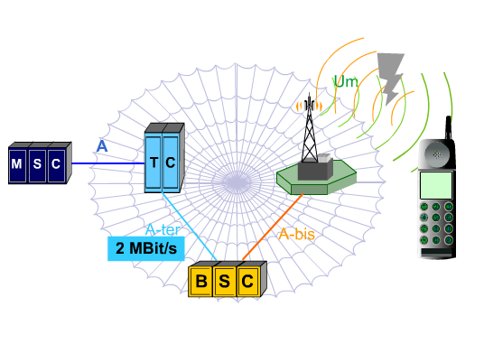
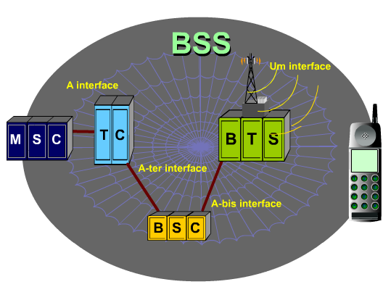
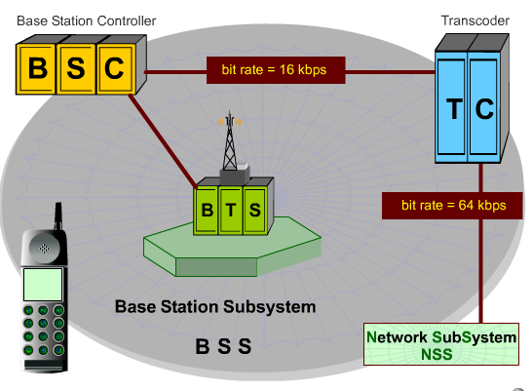
GSM
Base Station Subsystem
Base Transceiver Station.
Base Station Controller
Transcoder.
Network SubSystem
Mobile switching center.

Slide 7
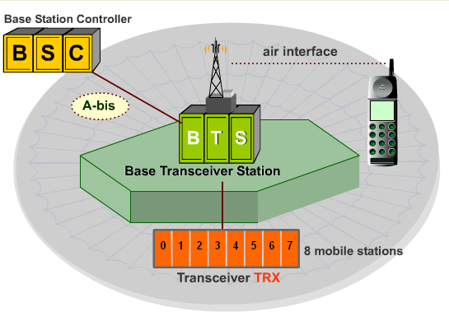
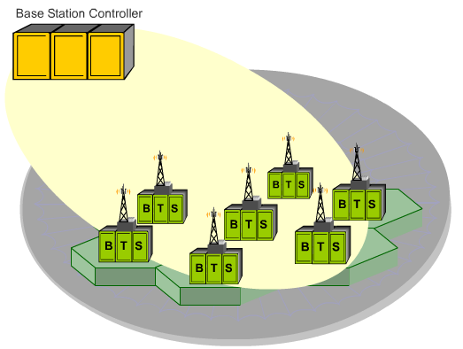
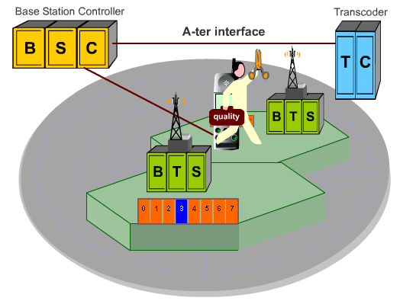

Slide 8
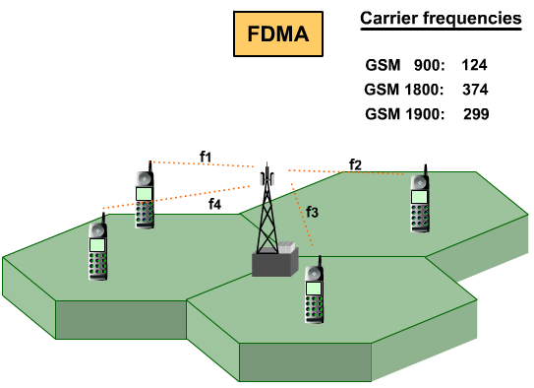
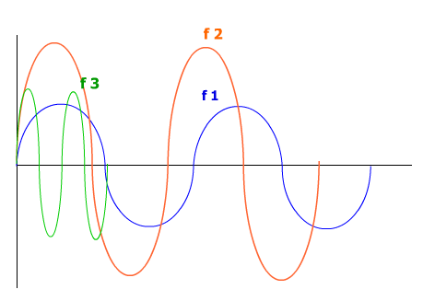
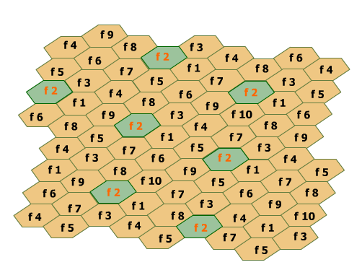
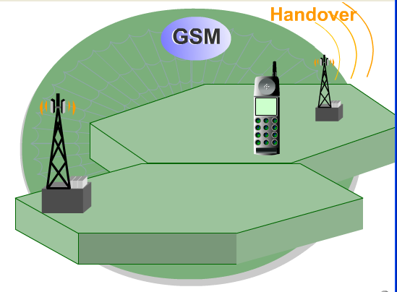
Multiple frequencies

Slide 9
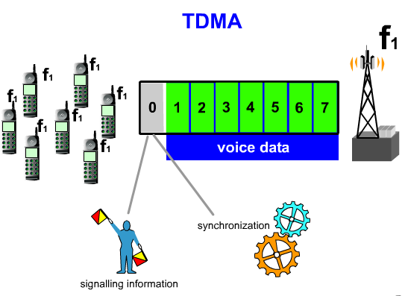
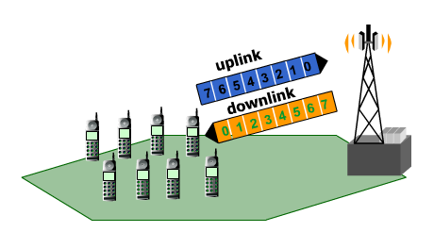
Eight mobile stations simultaneously TDMA
TIME DIVISION MULTIPLE ACCESS (TDMA)

Slide 10
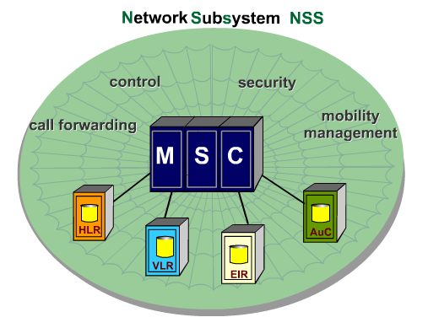
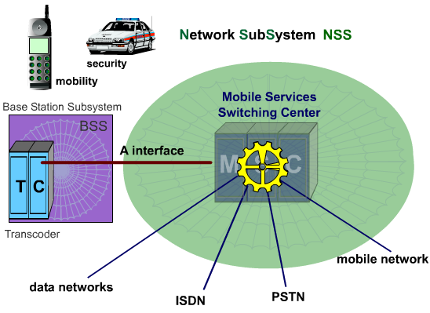
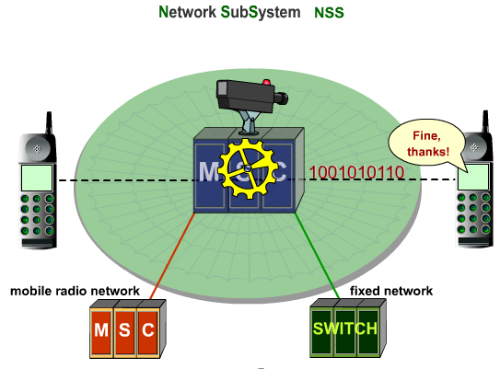
PSTN Public switched telephone network
ISDN integrated service digital network

Slide 11
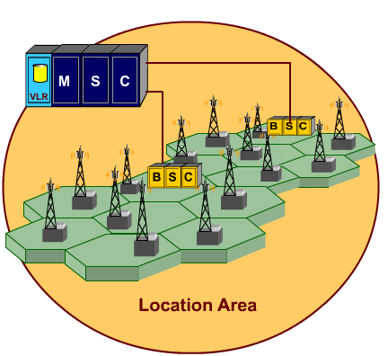
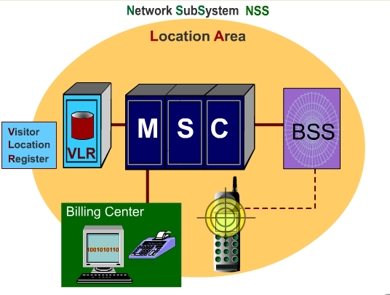
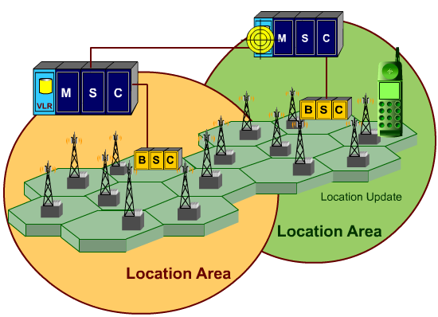
Visitor Location Register

Slide 12
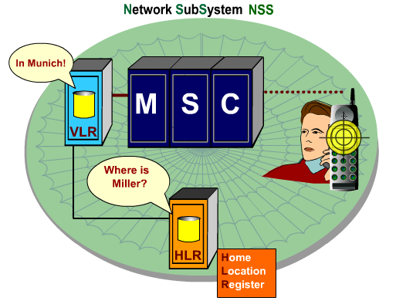
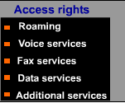
Home Location Register

Slide 13
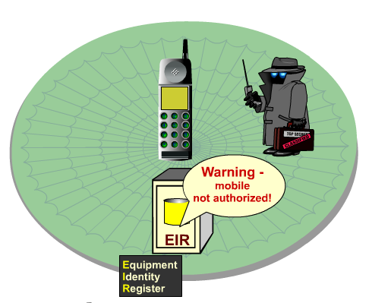
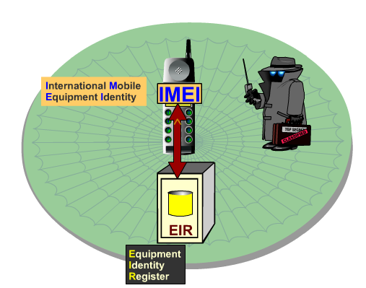
Equipment Identity Register

Slide 14
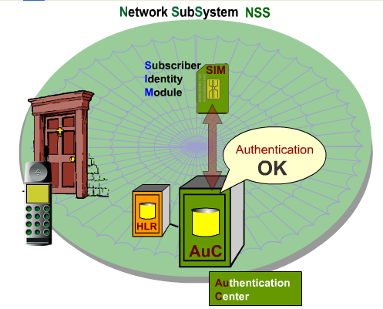
Authentication Center

Slide 15
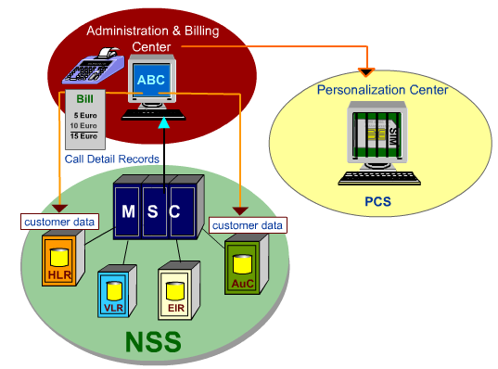
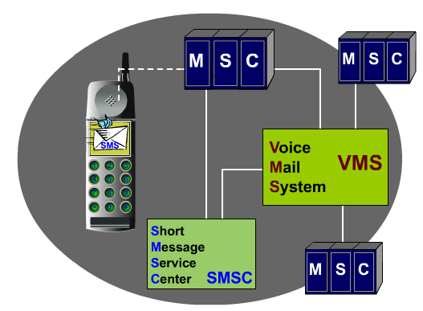
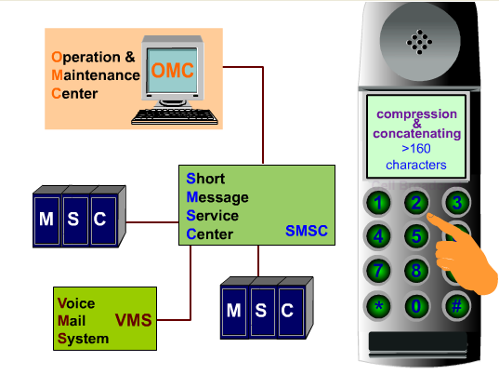
Billing Center

Slide 16
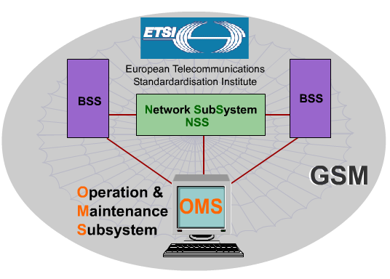
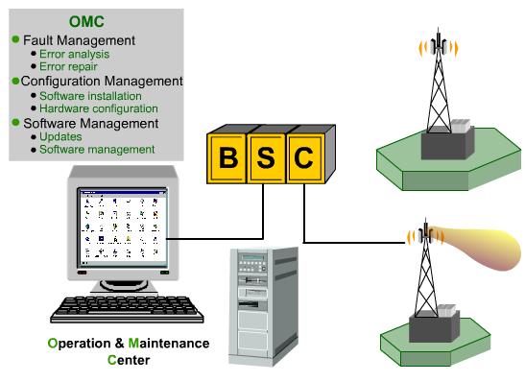
Operation & Maintenance Center

Slide 17
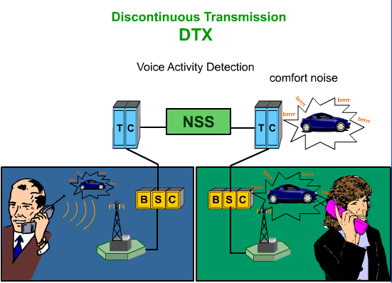
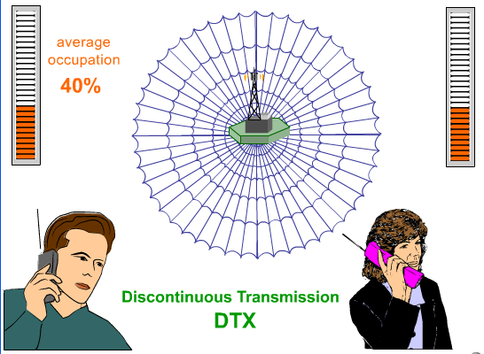
Discontinuous Transmission
Introduce Comfort noise.
Improve average occupation.

Slide 18
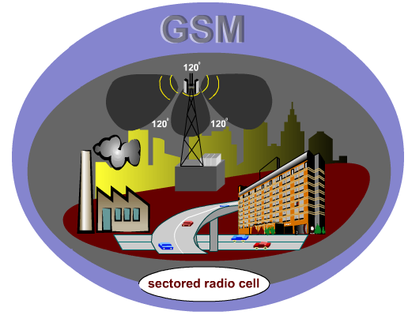
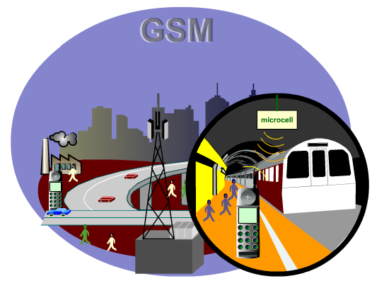
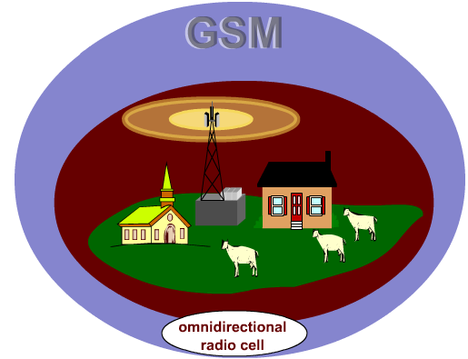
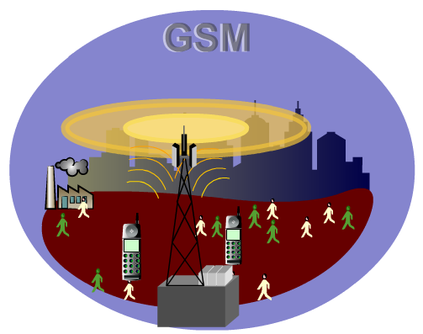
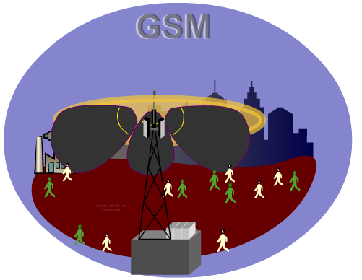
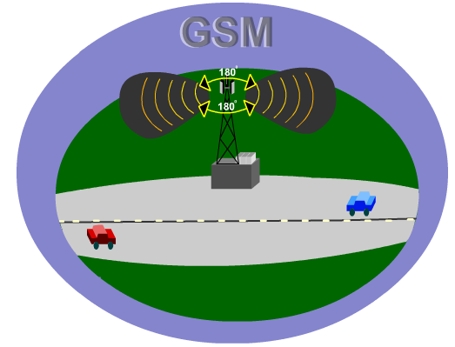
Adapted patterns to context

Slide 19
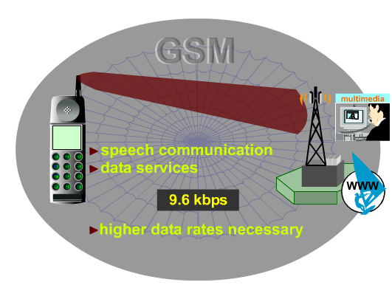
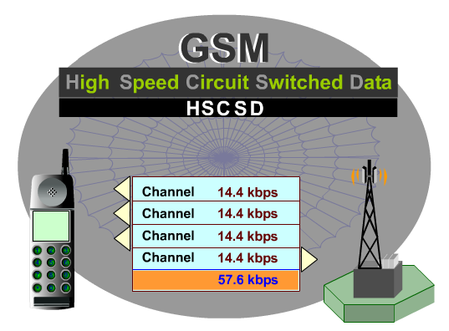
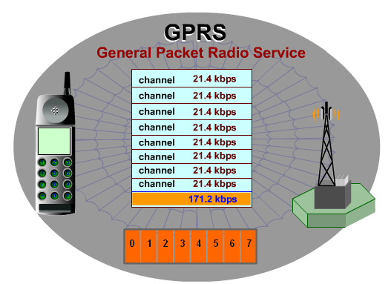
Evolution
GPRS is Packet switch.
With HSCSD is a first step to global multimedia.
Eight subscribers/channel.
If there are more subscribers number channels are reduced.
Requires some infrastructure modifications.

Slide 20
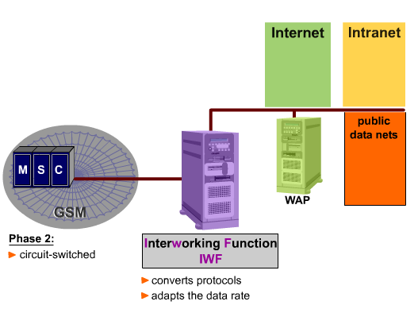

Slide 21
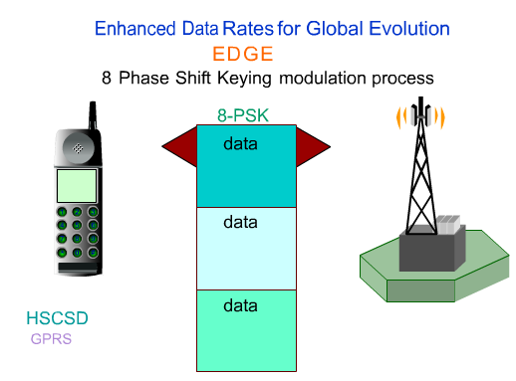
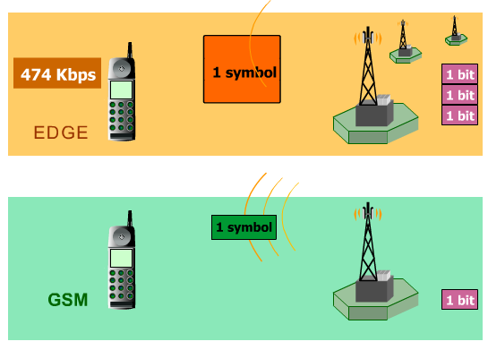
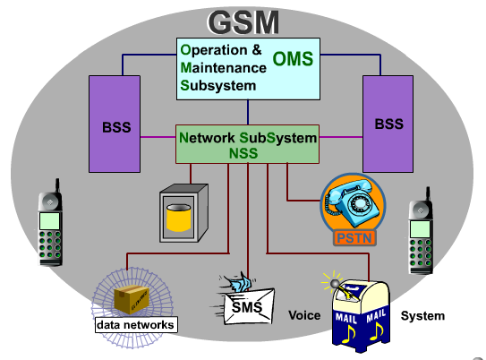
Enhanced Data Rates Global Evolution
Bit error sensitive need more quality of signal.
Allows 475 Kbps per User (3 times more GSM).
Subscribers use all eight time slot.

Slide 22

UMTS
Universal Mobile Technology System
Need for universal standard
Support for packet data services
IP data in the core network
IP radio access
New services in mobile multimedia need higher data rates and flexible utilization of the spectrum
FDMA and TDMA are not efficient enough
TDMA wastes time resources
FDMA wastes frequency resource
Direct sequence CDMA can exploit the whole bandwidth constantly
WCDMA was selected for a radio access system for UMTS (1997)
Bitrate 2 Mbps but realistic 144 or 384 kbps
Requires considerable changes of network architecture.

Slide 23


At end of 1998 different standardization organization got together and created 3GPP, 3rd Generation Partnership Project.
5 Founding members: ETSI, ARIB+TTC (Japan), TTA (Korea), T1P1 (USA)
CWTS (China) joined later.
Different companies are members through their respective standardization organization.

Slide 24





Wideband Code Division Multiple Access (WCDMA)
Spreadspectrum
Distinguish between individuals subscribers

Slide 25



Slide 26


Radio Network Controller RNC
Owns and controls the radio resources in its domain.
Mapping of QoS Parameters into the air interface
Air interface scheduling
Handover control
Outer loop power control
Admission Control
Initial power and SIR setting
Radio resource reservation
Code allocation
Load Control
Node B
Main function to convert the data flow between Uu and lub interfaces
Measurements
Innerloop power control
Innerloop power control
Measures the signal levels and compares this to the target value and if the value is higher than target then power is lowered otherwise power is increased.

Slide 27





Code Division Duplex CDD +FDD+TDD
Frequency Division Duplex FDD
All subscriber uses the same frequency simultaneously
Time Division Duplex TDD

Slide 28


Improvements
Link Adaptation
HIGH SPEED DOWNLINK
PACKET ACCESS
(HSDPA)
HIGH SPEED UPLINK PACKET
ACCESS(HSUPA)

Slide 29



LTE
Long term Evolution
Enables high bit rates with low latency.
Packet switched.
FDD and TDD.
ATsinc(fT)
Other sinc in each zero is OFDM principle
f
1/T , 2/T , 3/T ...
x0·Π(t/T)
x1·Π(t/T)· e^(j2Πt1/T)
...
xn·Π(t/T) · e^(j2ΠtN/T)

Slide 30


Slide 31



Tools
G-NetTrack Lite
Radio Mobile
Google Earth

Slide 32

5G
Everything you need to known about 5G

Slide 33



Wimax IEEE 802.16
Worldwide Interoperability for Microwave Access
First standard from 2001
With license 3,5 GHz Only Operators
Without License 2,5 GHz
Allowed to use WiFi frequencies.
Emission power adjustable automatically.
QoS implemented.
Error correction techniques.
Works without direct vision (NLOS).

Slide 34


Orthogonal Frequency Modulation Access OFDMA

Slide 35


Multiple Input Multiple Output MIMO

Slide 36



Beamforming

Slide 37



Standard | 802.16, 802.16a, 802.16c | 802.16d (802-16-2004) | 802.16e
Completed | 2001, 2002, 2003 | July 2004 | 7 Dec. 2005
Frequencies | 10 - 66 GHz | 2 - 11 GHz (3.5 and 5.8 GHz) | 2 - 6 GHz (2.3 and 2.5 GHz)
Conditions | LOS (line of sight) | Near-LOS | No LOS
Channel width | 20-28 MHz | 1.75-20 MHz | 1.25-20 MHz
Throughput | Up to 134 Mb / s | Up to 75 Mb / s | Up to 75 Mb / s
Transmission | SCA (single carrier) | OFDM 256 | OFDMA 2048
Mobility | Fixed | Fixed and Portable (Nomad) | Fixed and Mobile (roaming)
Range | 5 Km | 30 Km | 10 Km
Market | Urban Market. Internet access of buildings | Urban, suburban, rural. SMEs, Wifi. Wireless bridges | Access to laptops, PDAs, smart phones

Slide 38

Wifi 802.11
IEEE STANDARDS
802.2 Logical Link Control LLC
LLC
802
General view
802.11 WLAN
Data Link PDU: Frame
802.1
Management
802.3
CSMA/CD Ethernet
802.4
Token Bus
802.5
Token Ring
802.6
Optical FIber
802.15.1
Bluetooth
802.16
Wimax
MEDIA ACCES CONTROL
802.11
IR
802.11
FHSS
.11a
OFDM
.11b
DSSS
.11g
DSS
OFDM
Physical PDU: Bit
SONET
SDH
Frame 802.3
Generic frame 802.11
Control Frame | Duration | Receiver address | Transmitter address | Ethernet SA,DA or BSSID | Seq | Address 4 | Data | Checksum
2 bytes | 2 bytes | 6 byte | 6 bytes | 6 bytes | 2 bytes | 6 bytes | 0-2312 bytes | 4

Slide 39


Access Point (AP)
BSS
The Basic Service Set is a term used to describe the collection of Stations which may communicate together within an 802.11 network. The BSS may or may not include AP which provide a connection onto a fixed distribution system such as an Ethernet network.
Convert 802.11 frames to Ethernet and vice versa.
It can be a bridge or a router
Provides wireless-to-wired capabilities
All communications within the BSS are carried through the AP, even between wireless stations
How are packets routed?
In the association procedure, the AP saves the MAC of the wireless node in its routing tables.
The AP always broadcasts frames (ARP).
Any IP packet that reaches the network towards a wireless node i used by ARP to guess MAC address.
The AP broadcasts wirelessly all packets with destination MAC address stored in its table.

Slide 40



Basic Operating Modes
DCF (Distributed Coordination Function)
Mandatory
There is no centralized control of the network
All stations are the same
It is the normal mode of operation
There can be collisions. CSMA/CA (Carrier Sense Multiple Access/Collision Avoidance)
PCF (Point Coordination Function)
The AP controls all transmissions
Can only be used in infrastructure mode
Its implementation is optional

Slide 41


1: A wants to transmit a frame to B. It detects the free medium and transmits.
2: While A is transmitting, C wants to send a frame to B. It detects the free medium (since it does not capture the emission of A) and transmits Range of B.
3. A collision occurs at the intersection so that B does not receive either frame.
1:RTS: I want to send a 500-byte frame to B.
2:CTS::Okay A send me that 500 byte frame.
I must be quiet for the next 500 bytes.
1: Before transmitting frame A sends an RTS (Request To Send).
2: B responds to RTS with a CTS (Clear To Send).
3. C does not pick up the RTS, but the CTS. You know that you should not transmit for the time equivalent to 500 bytes.
4. A sends your frame safe from no collide with other stations
RTS/CTS
If all stations are 'heard' directly to each other using RTS / CTS does not contribute anything and is a major overhead, especially in small frames. RTS=2304

Slide 42

BSSID
The Basic Service Set Identifiers is used to describe sections of a wireless local area network or WLAN. It recognizes the access point or router because it has a unique address which creates the wireless network. Thus, BSSID is simply the MAC address of a wireless access point or also known as WAP
Control Frame | Duration | Receiver address | Transmitter address | Ethernet SA,DA or BSSID | Seq | Address 4 | Data | Checksum
2 bytes | 2 bytes | 6 byte | 6 bytes | 6 bytes | 2 bytes | 6 bytes | 0-2312 bytes | 4
 |  | 111 | aaa | bbb
Host A to AP1
Control Frame | Duration | Receiver address | Transmitter address | Ethernet SA,DA or BSSID | Seq | Address 4 | Data | Checksum
2 bytes | 2 bytes | 6 byte | 6 bytes | 6 bytes | 2 bytes | 6 bytes | 0-2312 bytes | 4
 |  | bbb | 111 | aaa
AP1 to Host B

Slide 43
Control Frame | Duration | Receiver address | Transmitter address | Ethernet SA,DA or BSSID | Seq | Address 4 | Data | Checksum
2 bytes | 2 bytes | 6 byte | 6 bytes | 6 bytes | 2 bytes | 6 bytes | 0-2312 bytes | 4
 |  | 111 | aaa | xxx
Host A to AP1
Preamble | SFD | Destination address | Source address | Type | Data | FCS
56 bytes | 8 bytes | 48 byte | 48 bytes | 6 bytes | 0-1500 bytes | 32
 |  | xxx | aaa
AP1 to X

Slide 44
Preamble | SFD | Destination address | Source address | Type | Data | FCS
56 bytes | 8 bytes | 48 byte | 48 bytes | 6 bytes | 0-1500 bytes | 32
 |  | aaa | xxx
AP1 to X
Control Frame | Duration | Receiver address | Transmitter address | Ethernet SA,DA or BSSID | Seq | Address 4 | Data | Checksum
2 bytes | 2 bytes | 6 byte | 6 bytes | 6 bytes | 2 bytes | 6 bytes | 0-2312 bytes | 4
 |  | aaa | 111 | xxx
Host A to AP1

Slide 45

1:Tracking
2:Authentication
3:Association
SSID
Service Set Identifier, which is a 32-character sequence that uniquely identifies a wireless LAN (WLAN). In other words, the SSID is the name of the wireless network.
BEACON
Control frame that the AP launches so regular (usually every 100ms). Contains the SSID and other network information, such as the clock (for synchronization of stations and APs) or the speeds supported by the network.
It is the process by which stations "discover" the access points (APs) to which they can connect.
Open-system or Shared Key
Roaming
If a station moves and changes cells it will detect the beacon of another more powerful AP and change its registration.
Only possible if authentication has previously occurred.
The association allows the AP to assign an association identifier (AID) to the client
​​The process is initiated by the client. The AP responds indicating success or failure

Slide 46

WEP
Secret key shared between sender and receiver of length 64 or 128 bits
CRC-32 is applied to the data "Integrity Check Value"
Secret key + initialization vector (IV) Seed
1: The authentication key is previously known and is never transmitted.
2: AP: Generate a random challenge.
3. The station encrypts the challenge using the known key.
Generator random numbers
Encryption Key K
Random Byte b
WEP is vulnerable and insecure. The 802.11 committee has been widely criticized for its standardization.
Data Byte p
Data Byte encrypted c
To decrypt p = c b

Slide 47

Radius Server
Wi-Fi Protected Access (WPA)
AP
Client
The WEP key is replaced by a password 128-bit different for each packet. Temporal Key Integrity Protocol (TKIP).
Mutual Authentication
EAP-TLS
EAP-Transport Layer Security
Mutual Authentication implementation
LEAP
“Lightweight” EAP
PEAP
“Protected” EAP
One Time Passwords (OTP)
GTC(Cisco) & MSCHAPv2 (Microsoft) versions

Slide 48

Radius Server
Wi-Fi Protected Access 2 (WPA2)
AP
Client
IEEE 802.11.i Based
Advanced Encryption Standard
Access IEEE 802-11i and PSK
Users AES and TKIP can be in the same network

Slide 49

802.11 | Release | f(GHz) | Bandwidth (Mhz) | Data Rate per stream (Mbit/s) | MIMO | Mod. | Indoor (m) | Outdoor (m)
- | june 1997 | 2.4 | 20 | 1, 2 | 1 | DSSS | 20 | 100
a | sept 1999 | 5 | 20 | 6, 9, 12, 18, 24, 36, 48, 54 | 1 | OFDM | 35 | 120
b | sept 1999 | 2.4 | 20 | 1, 2, 5.5, 11 | 1 | DSSS | 38 | 140
g | June 2003 | 2.4 | 20 | 1, 2, 6, 9, 12, 18, 24, 36, 48, 54 | 1 | OFDM,DSSS | 38 | 140
n | sept 2009 | 2.4/5 | 20 | 7.2, 14.4, 21.7, 28.9, 43.3, 57.8, 65, 72.2 | x4 | OFDM | 70 | 250
 |  |  | 40 | 15, 30, 45, 60, 90, 120, 135, 150

Slide 50



WiFi 6(ax)
WiFi ac
WiFi n

Slide 51



Tools
WiFi Heatmap - network analyzer&signal meter
Network Analyzer
Acrylic Wi-Fi Heatmaps

Slide 52










Zigbee IEEE 802.15.4
Low consumption digital broadcasting
Personal area network distances to 10–100 meters.
Data rates vary from 20 kbit/s (868 MHz band) to 250 kbit/s (2.4 GHz band)).
Coordinator, router and end device.

Slide 53


Bluetooth IEEE 802.15.1
Bluetooth is a short range wireless technology.
Personal area network distances to 10–400 meters.
ISM bands, from 2.402 GHz to 2.48 GHz
P2P
http://www.userk.co.uk/arduino-bluetooth-linux/
http://www.userk.co.uk/using-bluetooth-mate-gold-in-your-arduino-project/
sudo apt-get install -y fritzing fritzing-data

Slide 54
To finish....
Thanks!

Slide 55


Slide 56




Slide 57




Slide 58



Slide 59



Slide 60



Slide 61



Slide 62






Slide 63





Slide 64



